Slide 1
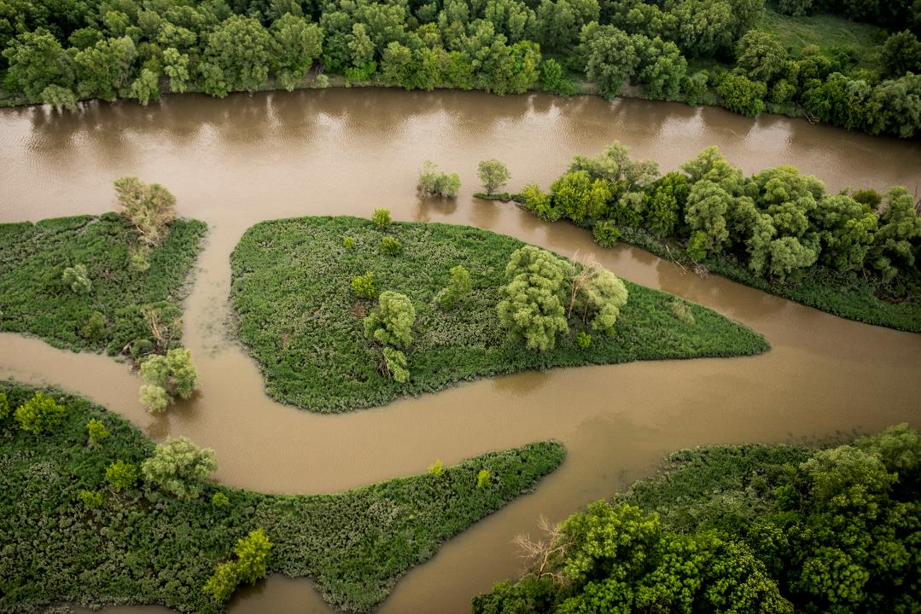
The potential of barrier removal to reconnect Europe's rivers
Claire Baffert, WWF EPO
LET IT FLOW – REMOVE BARRIERS, RESTORE RIVER ECOSYSTEMS, 8 July 2021
@Tomas Ulik

Slide 2
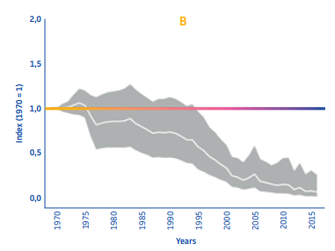
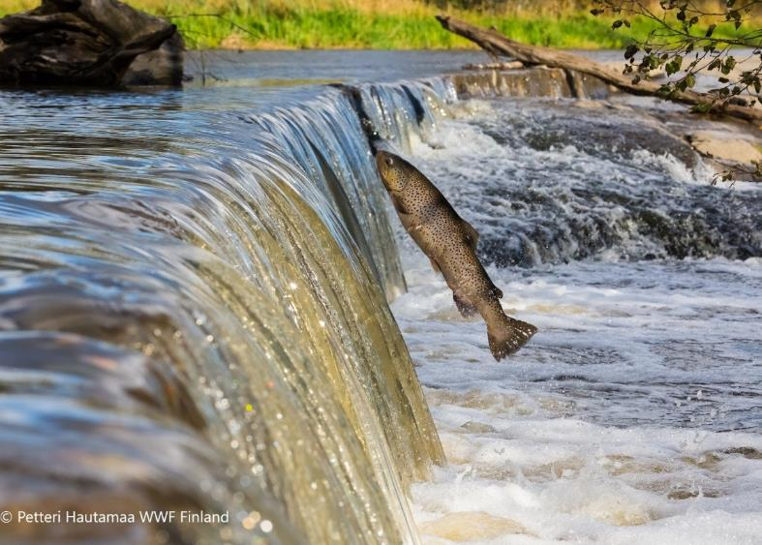
Freshwater migratory fish populations have dramatically collapsed in Europe
-93%
since 1970
Notes:
Hydromorphological pressures are the first reason for failing to achieve GES; they act as significant pressures for 34% of the surface water bodies.
Of those 34% surface water bodies, 20% fail to achieve GES because of barriers.

Slide 3
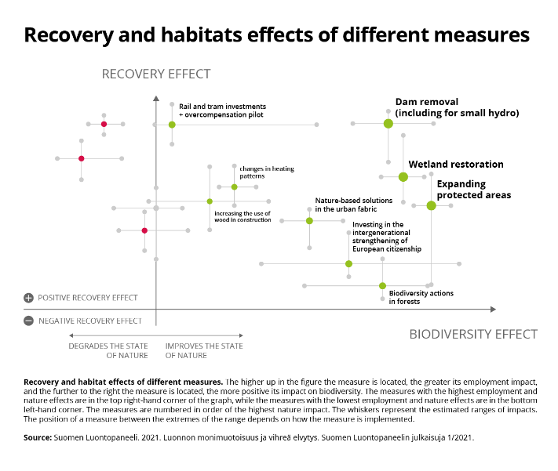
Barrier removal is the “green” measure with the highest impact on biodiversity and recovery

Slide 4
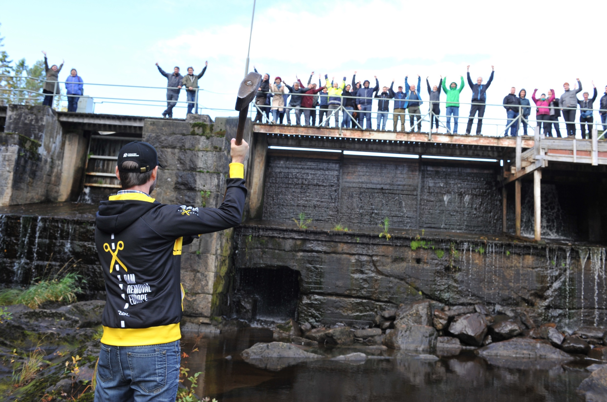
WWW.DAMREMOVAL.EU
MOMENTUM DAM REMOVAL
GROWING SUPPORT
Notes:
DAM REMOVAL EUROPE WAS STARTED IN 2016 TO INSPIRE, SHARE, CREATE AWARENESS AND CONNECT
THE FIRST 3 YEARS WE DEVELOPED THIS MOVEMENT, HELD SEMNIARS AND CREATE A NETWORK. WE DISCOVERED HOW IT WORKS IN EUROPE
THERE IS A BIG NEED FOR KNOWLEDGE, PRACTICAL KNOWLEGDE on how to remove dams, FUNDING FOR LOCAL PROJECTS, awareness

Slide 5
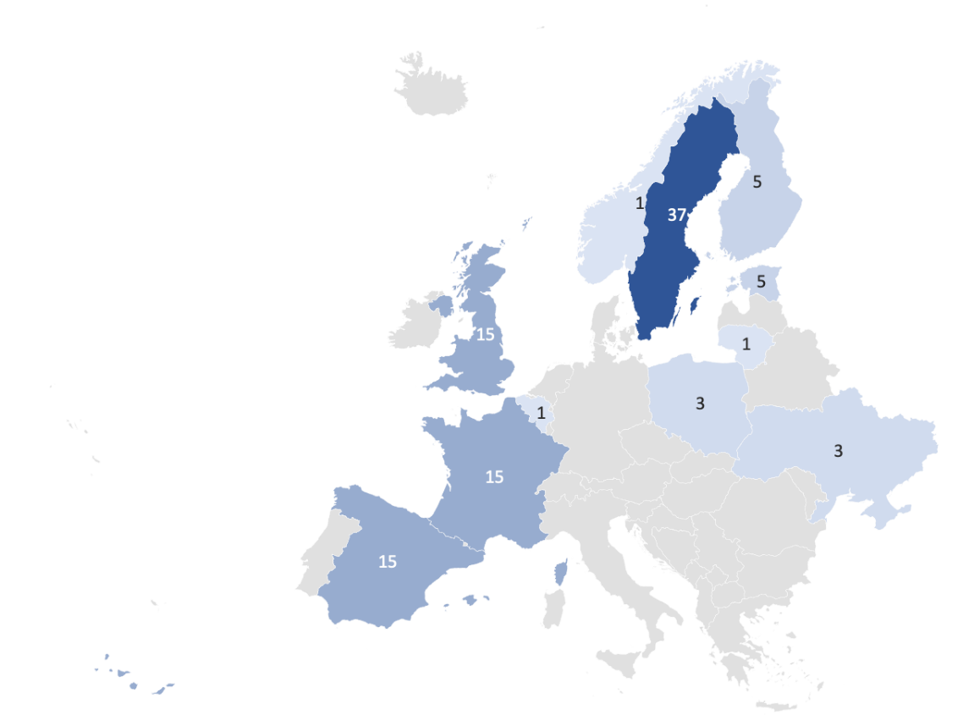
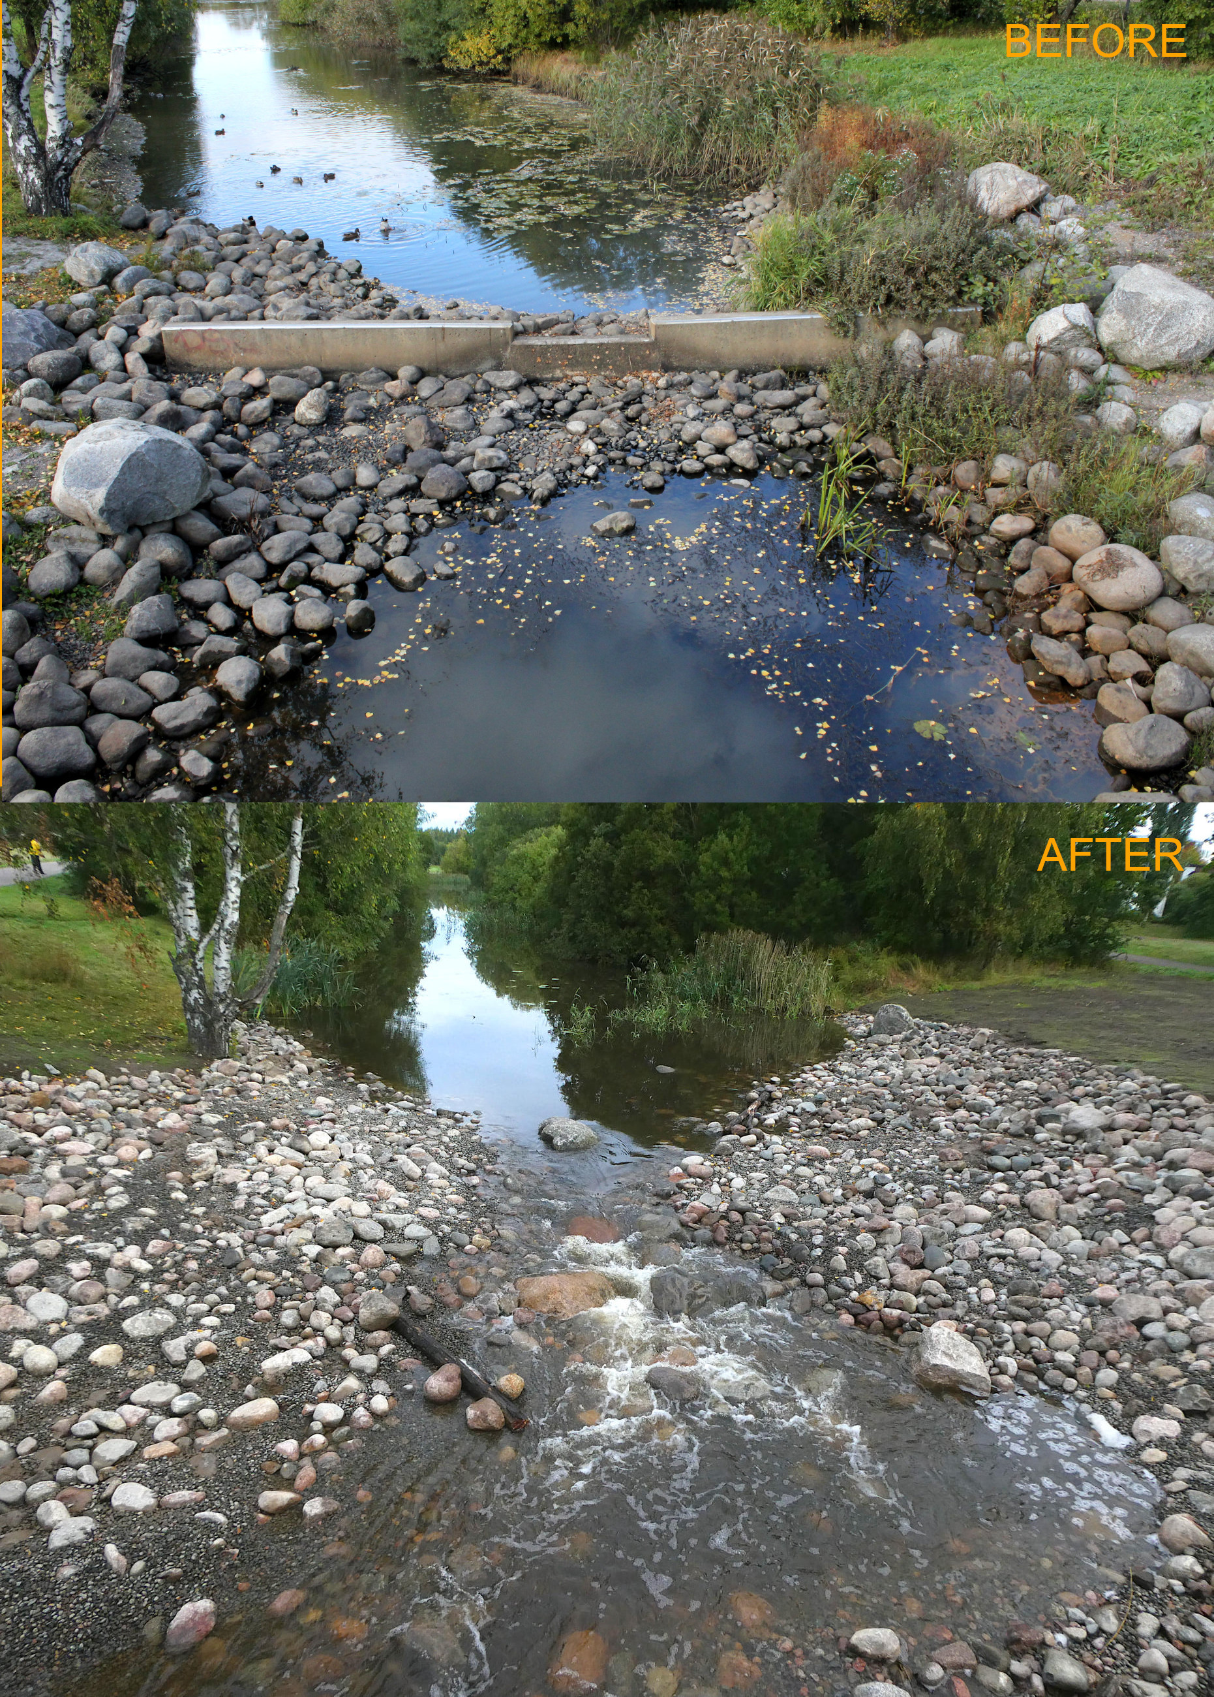
EVALUATING PROGRESS/POLICIES
2020
>100 removed

Slide 6
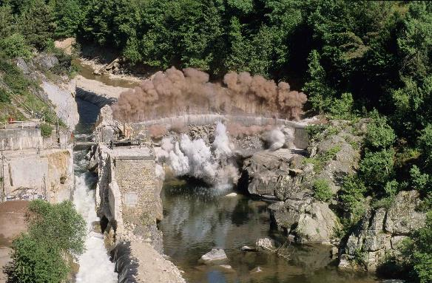
Learnings from river barrier removal across the globe
Dam removals : 60% less expensive than repair and maintenance over 30 years. Baker, C. et al (2015) Economic & Community Benefits from Stream Barrier Removal Projects in Massachusetts.
Free-flowing river sections have more recreational value than dammed sections. Getzner, M. (2015). Importance of Free-Flowing Rivers for Recreation: Case Study of the River Mur in Styria, Austria.
Dike relocation on the Elbe river reduced the flood stage by 0,5m upstream and up to 10 cm at a town 20 km upstream. WWF, Working with Nature to reduce Climate risks, 2019, pps 26-27.
Dam removal on the Sélune River would generate a threefold increase in suitable habitat for salmon juveniles. https://academic.oup.com/icesjms/article/75/6/2172/5056129#186876451.
©ERN
Notes:
at all the activities, such as walking, hiking, and wildlife observation, are mostly pursued along the free-flowing sections of the river, contrary to some existing empirical papers emphasizing the great importance of dammed-up river stretches for recreation

Slide 7
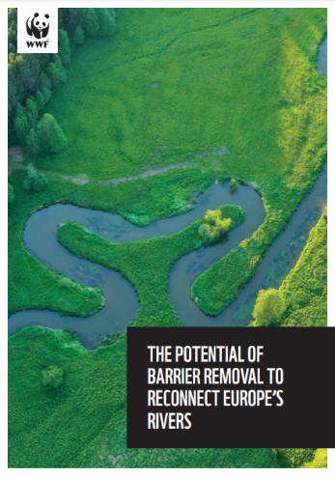
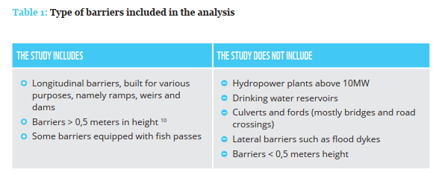
WWF analysed 30,000 barriers in large and medium-size rivers in Europe
Read the report here
Notes:
Data from the 2019 NGO report “Hydropower pressure on European rivers: the story in numbers” of about 23,000 barriers, amended by:
Individual survey/satellite analysis for 1,150 barriers,
Improved in particular for Mediterranean (reservoirs for other purposes than HPP) by GOODD and GRanD data sets (some 500 additional)
AMBER data (only the “dams” (about 61,000) and “weirs” (125,000) categories)
Detailed data provided by WWF partner organisations for Austria, Germany, the Netherlands, Romania, Slovakia, Spain and Switzerland for some 100 priority projects.

Slide 8
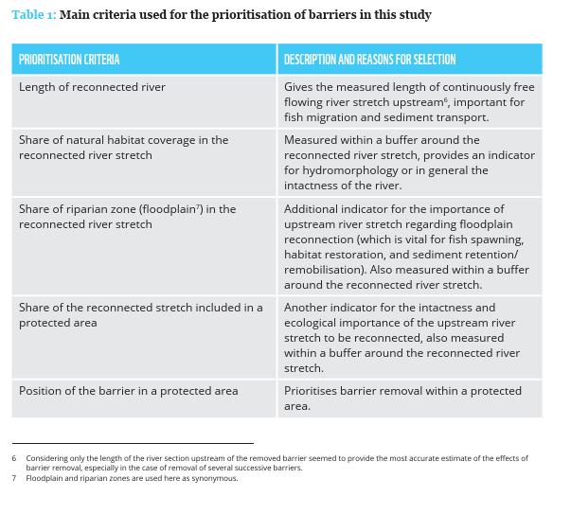
WWF analysis on barrier removal: criteria for prioritisation

Slide 9
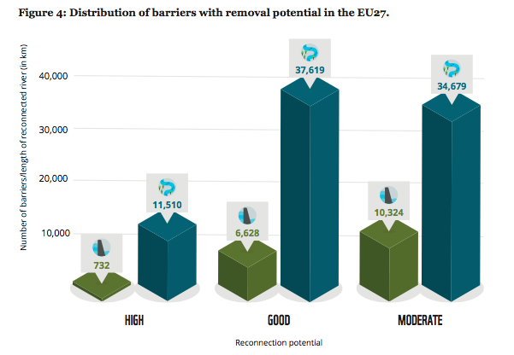
In the sample studied, nearly 50,000 km of rivers have a high & good potential to be made free-flowing again
This would require the removal of 7360 barriers.
Notes:
The reconnection potential per barrier removed is higher in regions with lower barrier density (e.g. Eastern Europe)

Slide 10
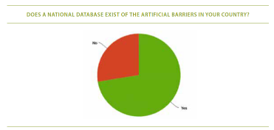
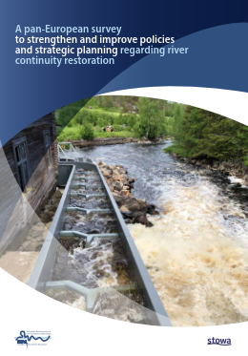
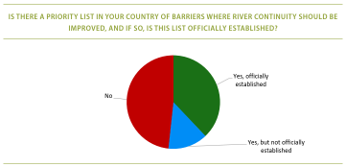
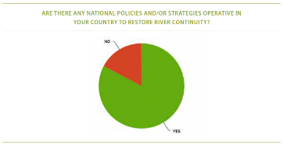
A legally-binding target on free-flowing river restoration is needed under the EU Nature Restoration Law
The conditions for taking action are already in place!
72%
52%
83%
Read the report here

Slide 11
A legally binding target would help achieve the objectives of the Water Framework Directive
WFD target – all water bodies in good status
WFD adoption
40% of water bodies in good status ; Hydromorphological pressures are the main pressure
2021
2027
2000
Free-flowing river restoration target
2023?
2030
European Parliament resolution on the implementation of the water legislation, 2020
“Calls on the Member States and the Commission to take all necessary action to minimise pressures on bodies of surface water in order to restore natural functions of rivers and protect ecosystems;”

Slide 12
The EU must aim higher than 25,000 km
25,000 km = only 2% of EU rivers
By removing 2,5% (2,500) of the 100,000 obsolete barriers, the 25,000 km target could be achieved
National Biodiversity Plan sets the objective of restoring 50,000 km of river continuity by 2030
WWF and NGOs recommend raising the EU target to 15% of rivers (178,000 km) restored to a free flowing state by 2030 - See advocacy paper

Slide 13
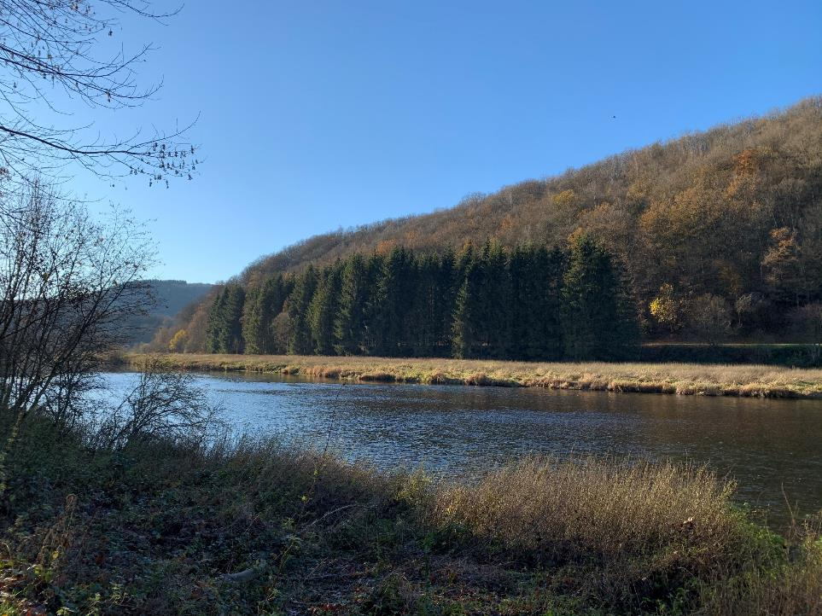
Thank you for your attention
Contact: Claire Baffert,
cbaffert@wwf.eu

