Slide 1
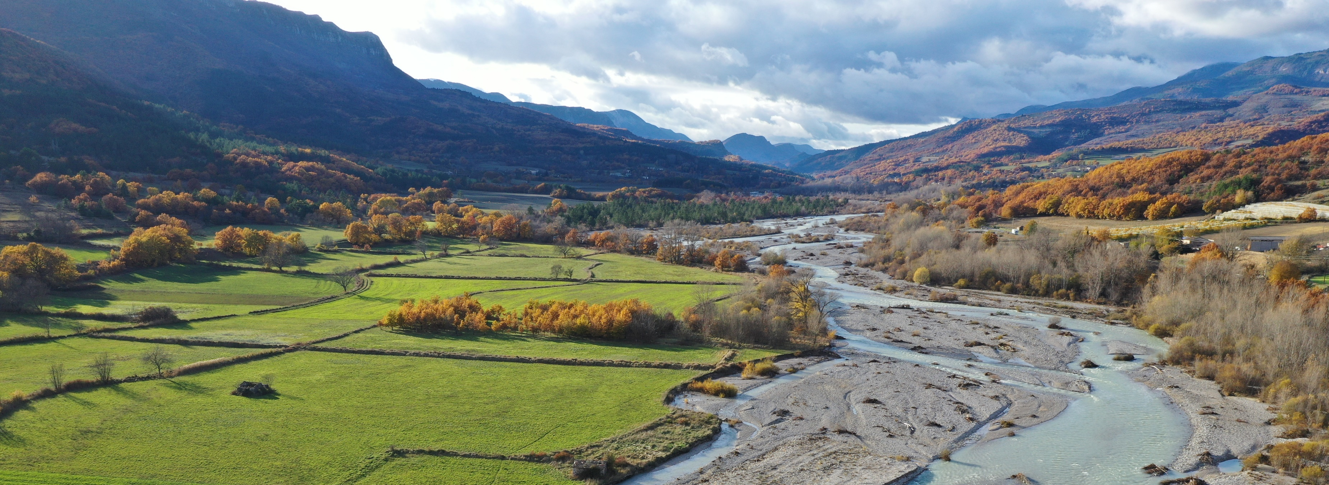
Restoring Europe’s rivers
Trine Christiansen, Ph.D. - Integrated water assessment expert
European Environment Agency
Trine.Christiansen@eea.europa.eu
Let it flow – remove barriers, restore river ecosystems, July 8, 2021

Slide 2
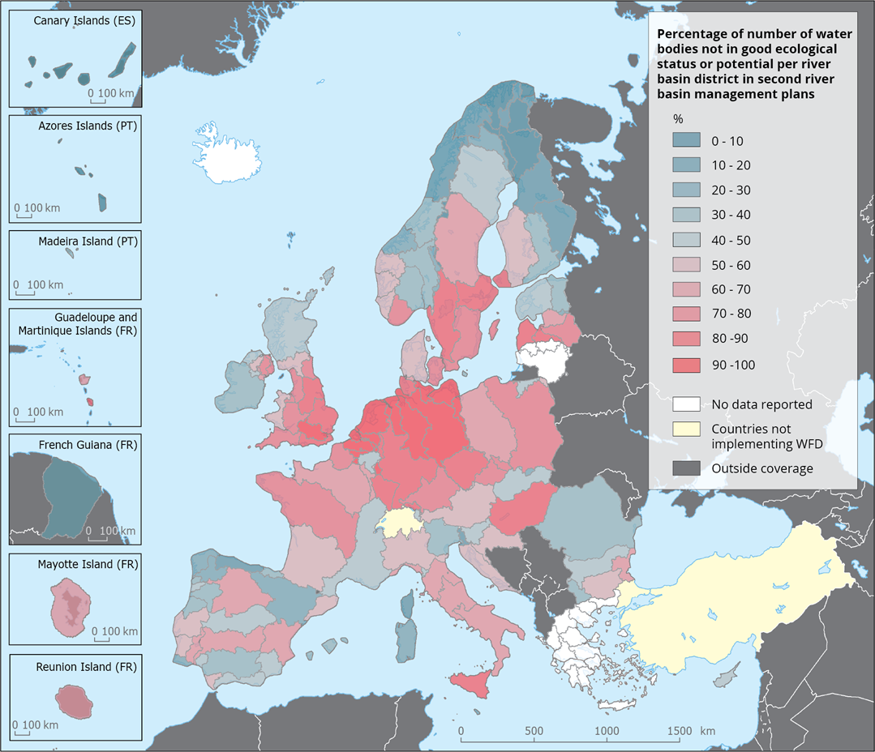
Europe's waters: Status and pressures 2018
44% of Europe’s surface water bodies achieve good ecological status
One of the most widespread pressures
Source: European waters -- Assessment of status and pressures 2018 — European Environment Agency (europa.eu)

Slide 3
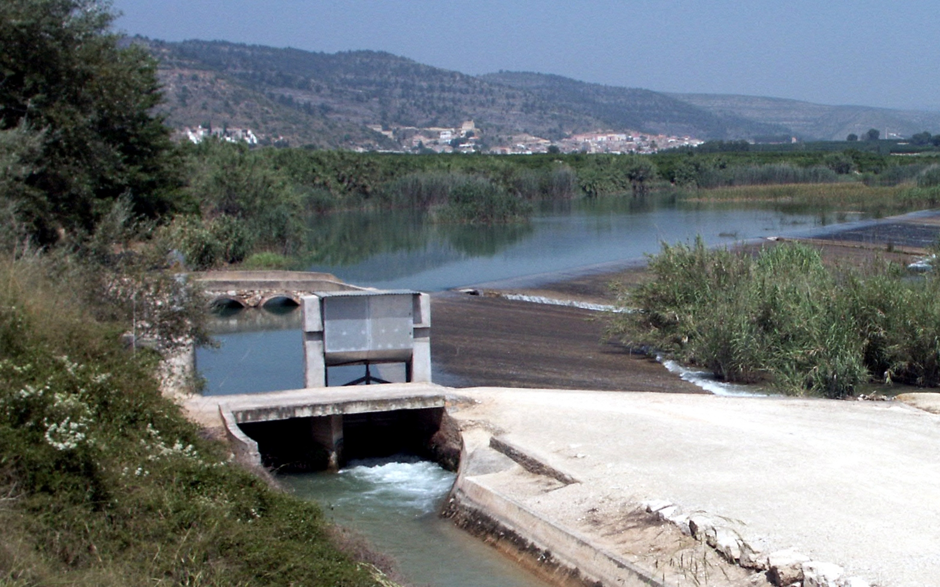
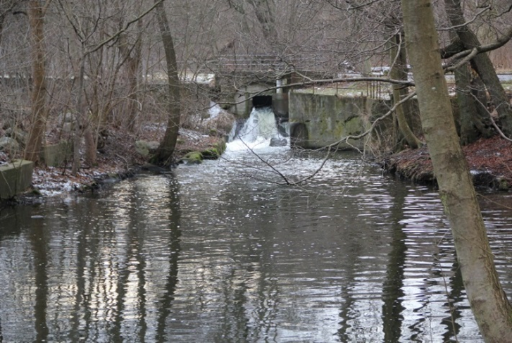
What is hydromorphology?
Hydromorphology refers to the morphology (shape), geology, and hydrological processes within a river, that in combination create and maintain habitats.
Pictures show examples of barriers creating hydromorphological pressures

Slide 4
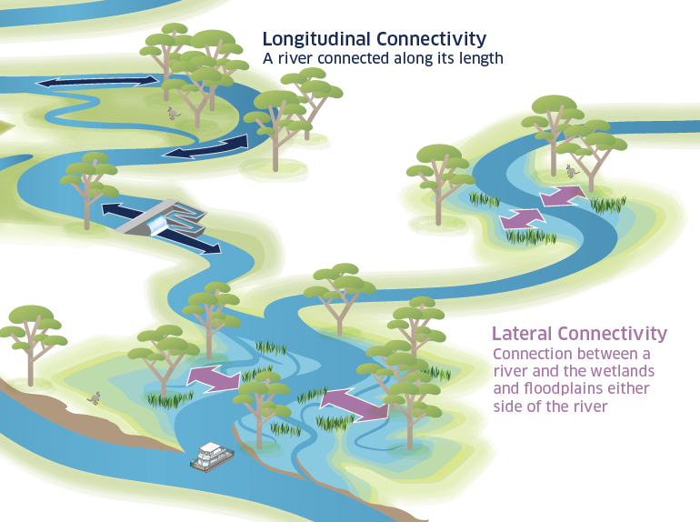
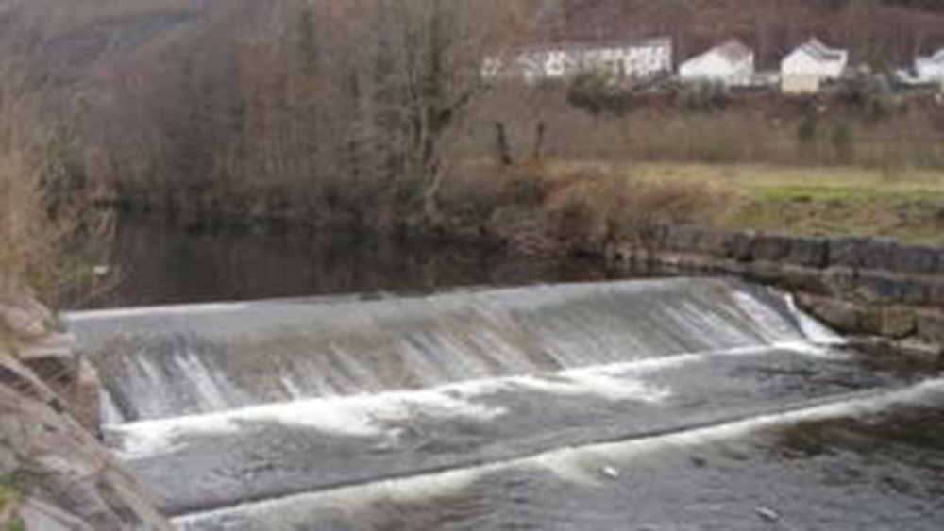
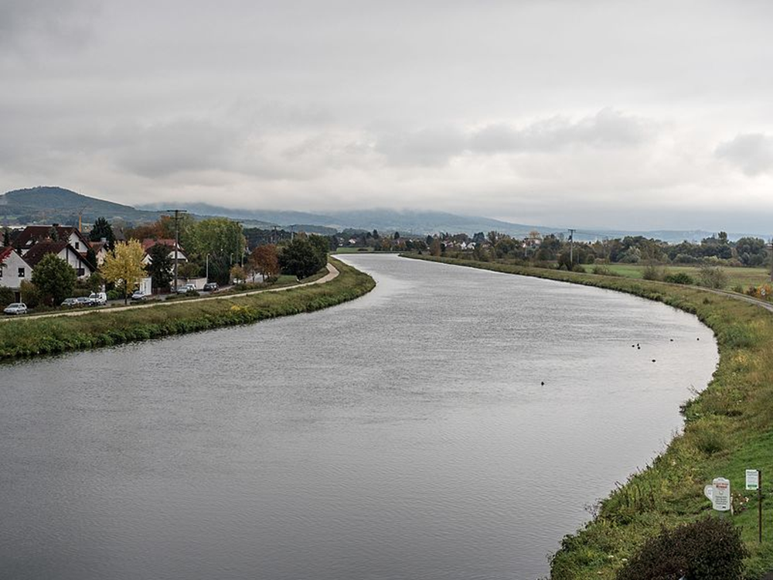
River connectivity is a key feature
Credit: Henri Cormont

Slide 5
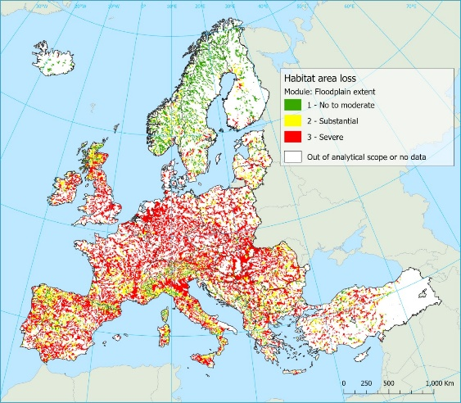
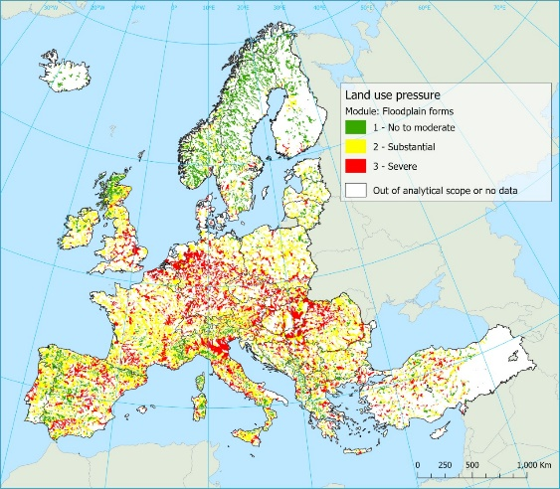
EEA assessment of floodplain condition: two indicators of lateral connectivity
In combination, the indicators suggest 80-90% of lateral connectivity in floodplains is substantially to severely degraded
Habitat area loss indicator
Land use pressure indicator
Source: https://www.eionet.europa.eu/etcs/etc-icm/products/preliminary-assessment-of-river-floodplain-condition-in-europe

Slide 6
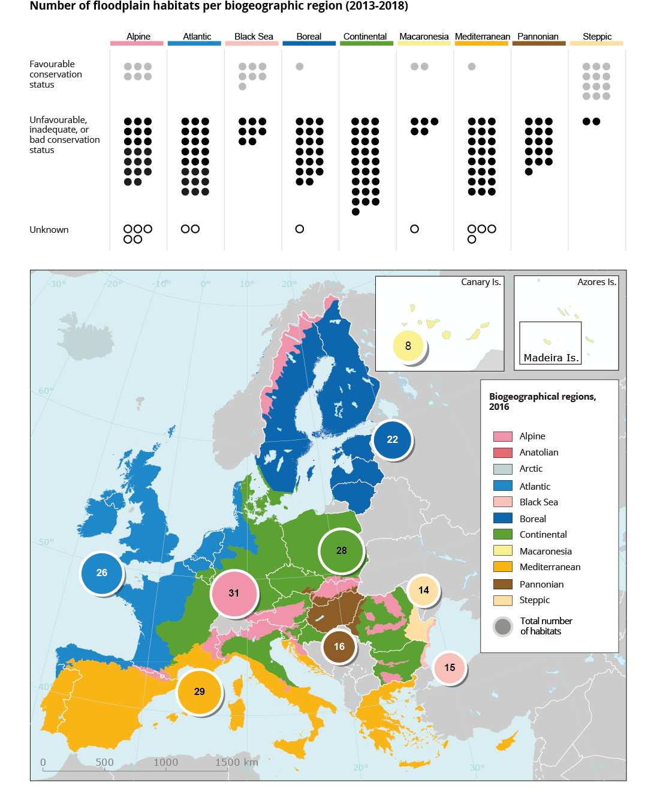
Only 17% of floodplain habitats are in favourable conservation status
Numbers in circles refer to number of assessments made
Source: Habitats Directive art. 17 reporting 2013-2018

Slide 7
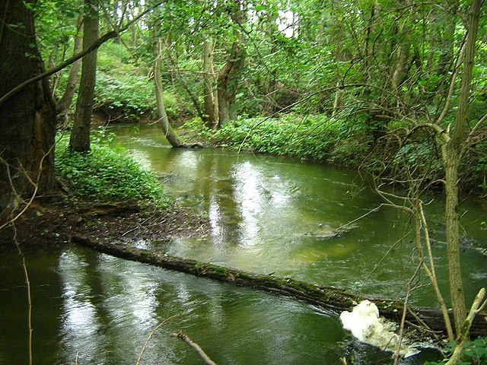
Biodiversity Strategy 2030 aims to improve the situation
Target to restore at least 25 000 km of rivers into free-flowing by 2030 through the removal of primarily obsolete barriers and the restoration of floodplains and wetlands.
Free-flowing means without barriers;
Targets both longitudinal and lateral continuity to improve habitats;
Has a time horizon beyond 2030: forthcoming Nature Restoration Law aims to set legally binding targets for 2050

Slide 8
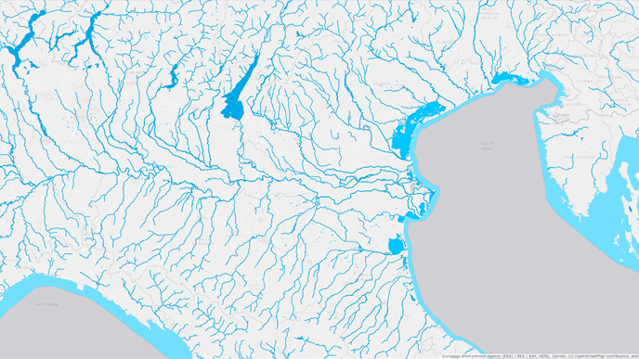
New targets bring new data needs to set baselines and show progress
Copernicus EU-Hydro product
EU-Hydro: a consistent and topologically connected river network – needs to include WFD water bodies;
Habitats Map: High resolution mapping of location and extent of protected habitats;
Lateral Barriers inventory: location and types of barriers to lateral connectivity (complementary to Amber Atlas)
Source: https://land.copernicus.eu/imagery-in-situ/eu-hydro/eu-hydro-river-network-database

Slide 9
Summary
Hydromorphological pressures are widespread in Europe’s rivers and have resulted in degradation of both lateral and longitudinal continuity of rivers as well as floodplain habitats.
Free-flowing river target of the Biodiversity Strategy 2030 builds on the importance of improving river continuity for reaching objectives of both Water Framework and Habitats Directives.
The primary aim of removing barriers is to restore rivers, their natural processes, and the surrounding habitats to improve biodiversity across Europe
Proper follow-up requires investments in filling information gaps

